Slide 1
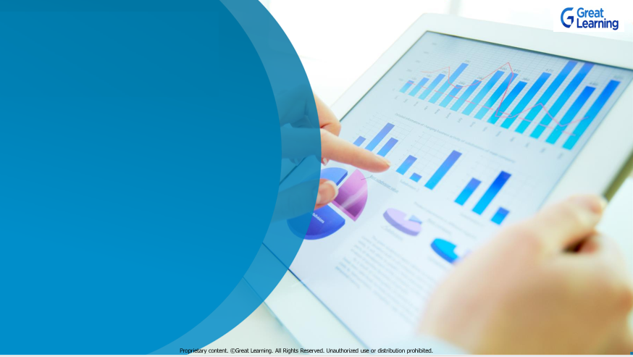
Python for Data Science
Week 2
Mentor Learning Session

Slide 2
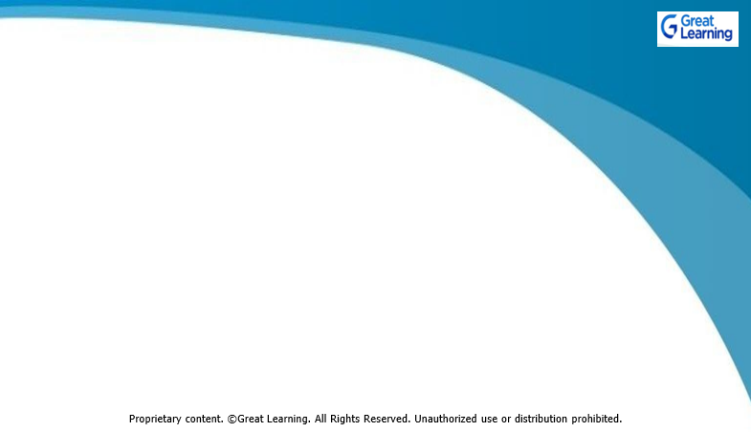

Expectation Setting
Make sure you watch all the videos and understand the concept thoroughly before joining the Mentor Learning Session.
Mentor Learning Sessions are not walkthrough of what is already covered in the videos. It will focus more on application. Case Study will be discussed to indicate how best knowledge can be applied in various real situations
Be Punctual and try to login on time to get the best learning experience.

Slide 3
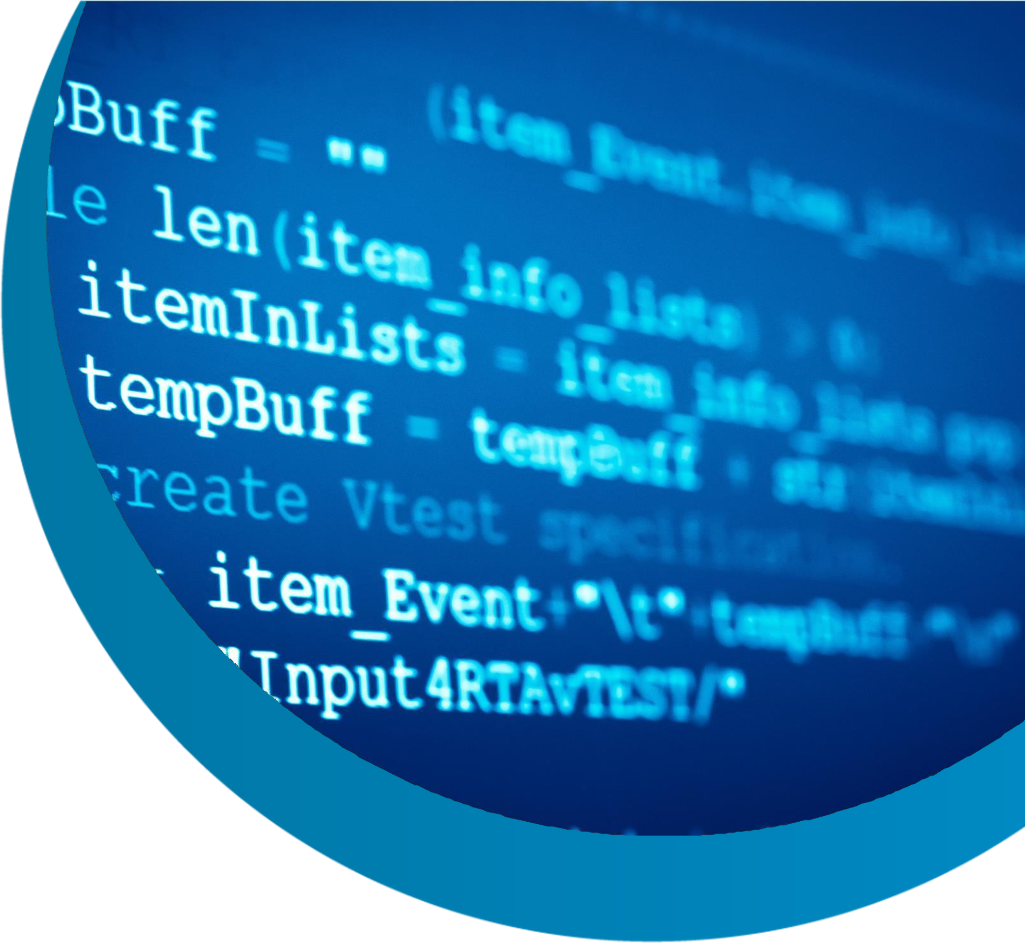
Learning objective of PDS :
Basics of Python (Week 1)
Numpy and Pandas -
Data Manipulation using Python
(Week 2)
Data Visualization using Python (Week 3)

Slide 4











Quick Review of what you learnt from the videos of Week 2
Can you name some important Python Libraries
How to install/uninstall a library?
How to read a dataset?
Which function is used to get statistical summary of a dataframe?

Slide 5

































Slide 6
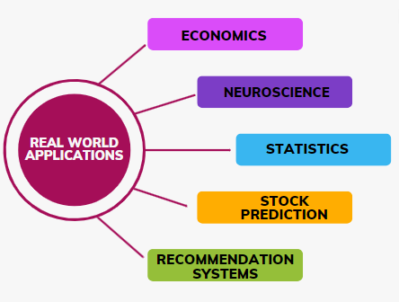
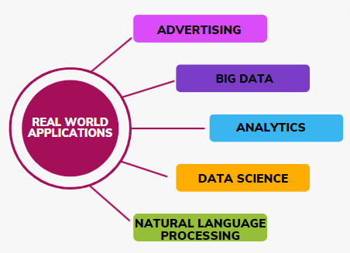




Pandas in Real world applications

Slide 7
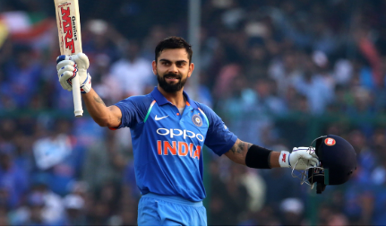
















Hands On Case Study
Performance Analysis of Virat Kohli
Virat Kohli is an Indian cricketer. He was born in Delhi, India on November 5,1988. Virat is the first player in ICC cricket history to win all 3 ICC awards in a single year- ICC ODI player of the year, ICC Test player of the year and ICC Player of the year award in 2018.
Objective- Analyze the batting performance of Virat Kohli using Pandas(dataframe and functions).

Slide 8

How to debug your code?
Try to debug on your own by reading & understanding the error
message- This is an essential step in the learning process.
Refer to Python Codebooks shared in the Program Overview course.
Discuss it with the Peers over WhatsApp groups. It will help others in the group understand various nuances of coding.
Search your problem on GL Community. It takes time to build competency in Python. Even the experts regularly search for help on platforms like StackOverflow.
Get your query resolved in the Mentor Sessions or via Program Support feature available in Olympus.

Slide 9
Any Doubts?

Slide 10

Thank You !!
Happy Learning

